Slide 1










BUSINESS PLAN
Notes:
born out of a real time growing problem in the education sector.
In today’s world, we often see lot of students are mentally lost from the classroom .
single teacher can't personally guide all the students
and students are struggling to learn at their own pace,
many job seekers are lagging their skills, which company demands, even they fell unprepared for the interviews
This gap between education and career readiness, especially in rural and
under-resourced areas, deeply inspired us. We thought—what if we could build something smarter? What if technology could actually understand and adapt to each learner individually?
we personally belive,
the best way to predict the future is create it

Slide 2
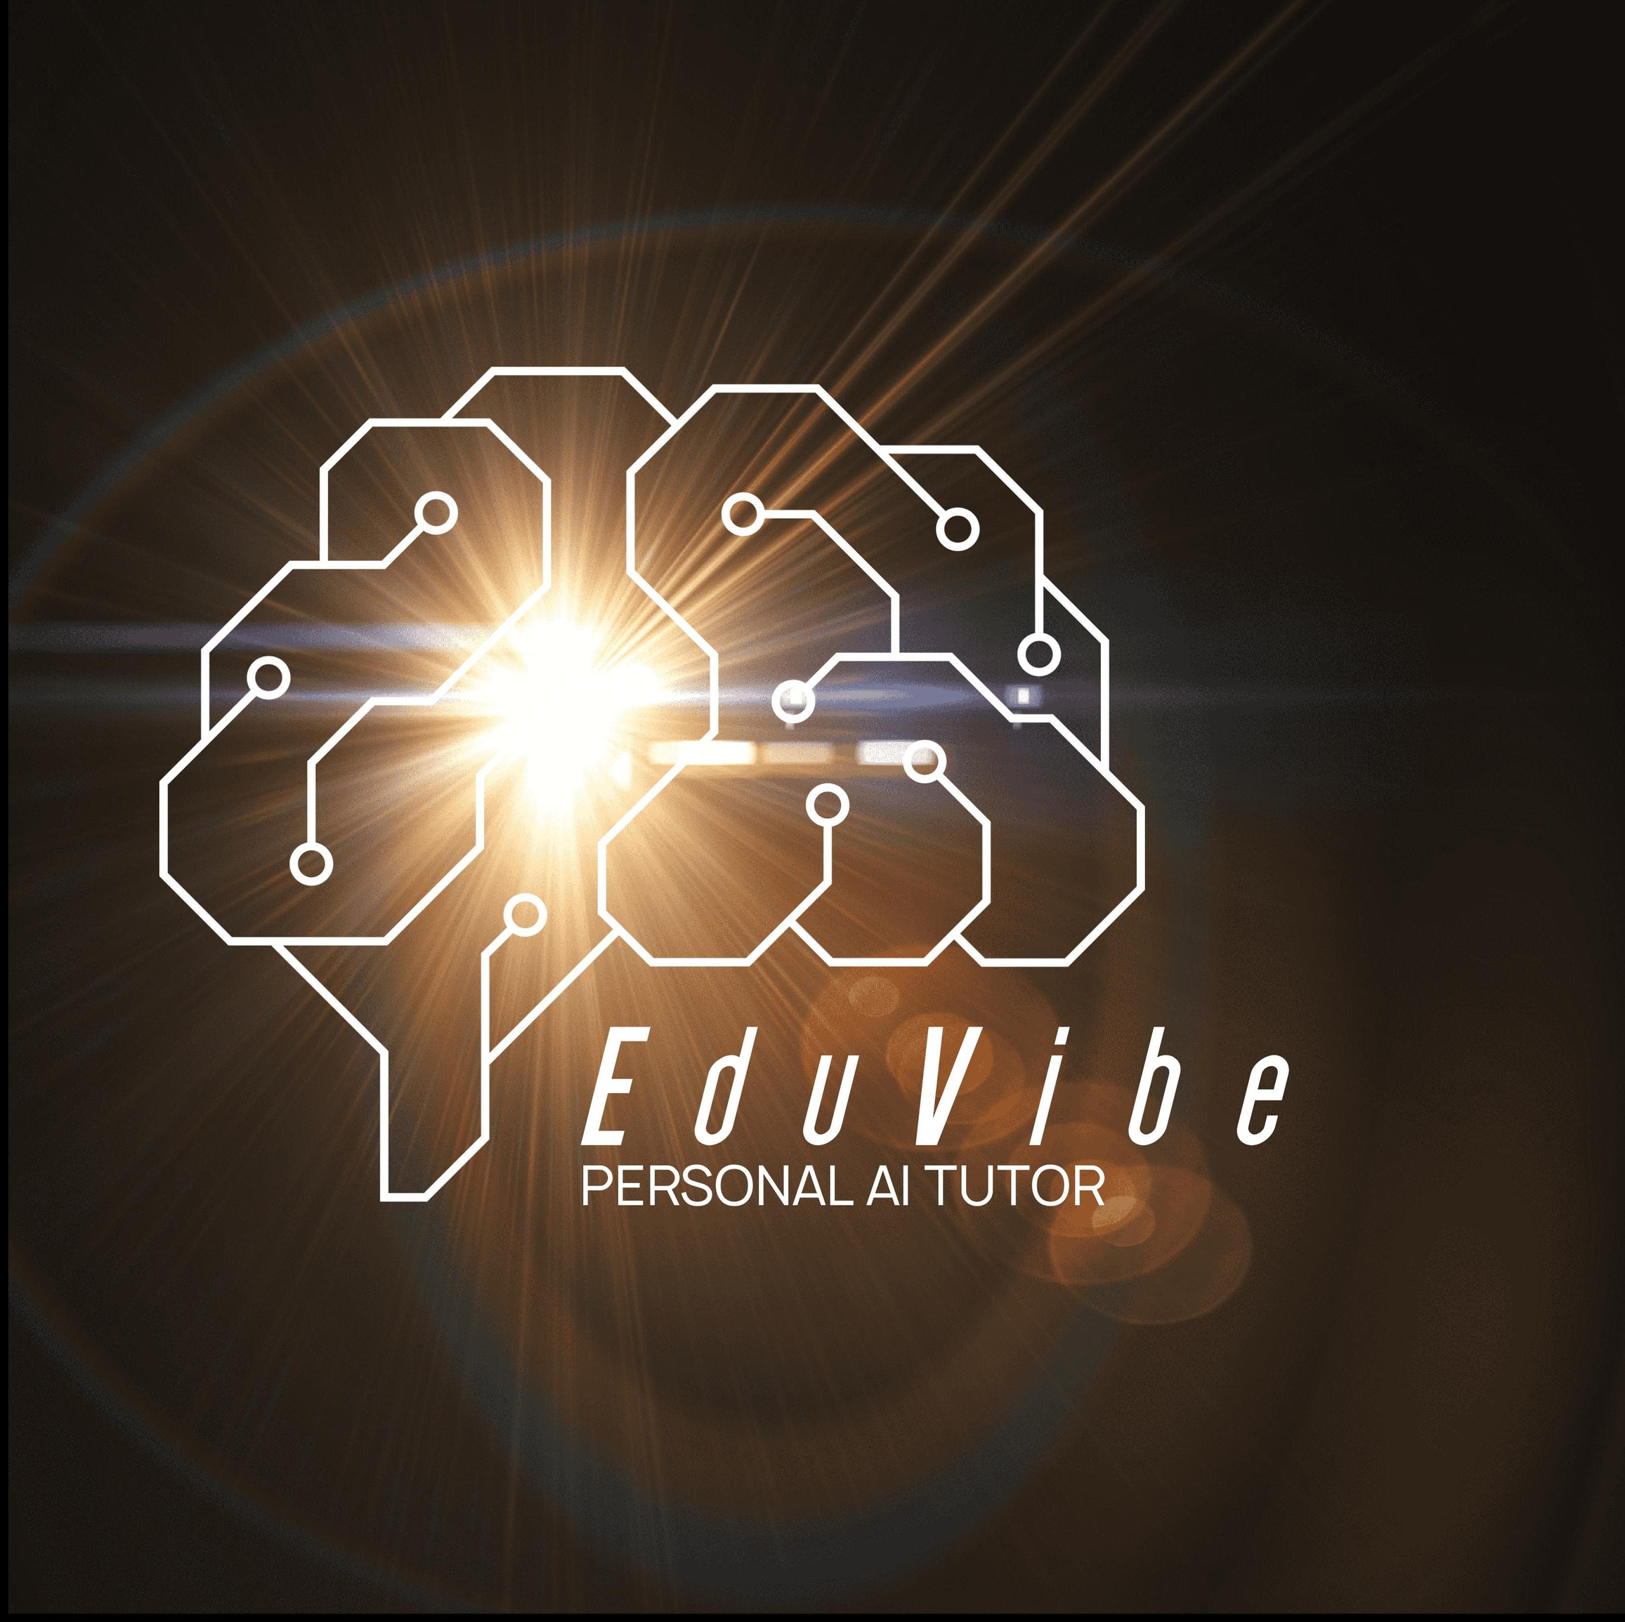
Notes:
It’s a personalized AI-powered learning and interview preparation platform that adapts to every learner's unique style and needs.

Slide 3








Introduction
Traditional education lacks personalization and practical skill development.
Many students feel unprepared for real-world job interviews and competitive careers.
EduVibe AI is an AI-driven EdTech platform that personalizes learning and bridges the gap between academics and employability.
Our solution adapts to the learner’s pace, style, and goals—offering AI-powered mock interviews, skill-building tools, and a mobile-first experience.
Built for students, professionals, and institutions with a vision of equitable, accessible education for all

Slide 4







Idea Generation

Slide 5
Observed a growing mismatch between what students learn and what the job market demands.
Interacted with peers and educators—common concerns included lack of interview prep, poor personalization, and inaccessible quality learning.
Brainstormed potential tech-driven solutions that could democratize personalized learning.
Inspired by how AI is transforming industries—we decided to apply it in education to enhance engagement and outcomes.
Thus, EduVibe AI was born: A solution combining adaptive learning with real-world readiness.

Slide 6
SCREENING

Slide 7
Uniqueness
Uses personalized learning algorithms and natural language processing to simulate a real tutor, offering a human-like, adaptive learning experience.
Notes:
“EduVibe AI is different from typical EdTech tools. It uses personalized learning algorithms and natural language processing, which makes the platform behave like a real tutor.

Slide 8
Justification
Moves away from generic, one-size-fits-all content by providing engaging, guided, and tailored learning paths for each student.
Notes:
This ensures students are not just watching content but are guided through it — making learning more engaging and adaptive to each individual’s pace and style.”

Slide 9
SOCIETAL RELEVANCE

Slide 10
Bridges educational gaps by offering equal access to AI-powered learning in both urban and rural areas.
Supports inclusive education and helps teachers by automating repetitive tasks, enhancing overall teaching and learning efficiency.
Notes:
“EduVibe AI addresses important challenges in both urban and rural education. It brings quality learning to more students by using AI-powered lessons that adjust to their needs.
It also supports teachers by automating tasks like grading and tracking, helping them focus more on real teaching. Overall, it promotes inclusive and accessible education.”

Slide 11
PROCESSING

Slide 12
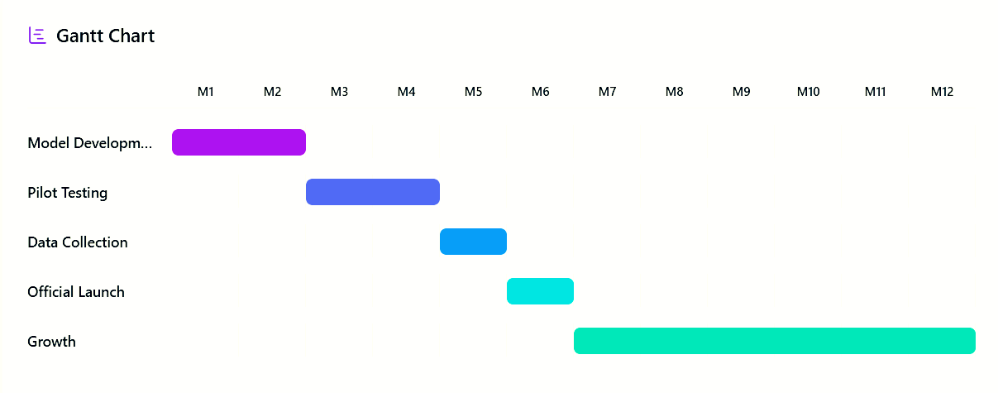
Notes:
This is the timeline for our startup

Slide 13
Timline
Month 1-2: Prototype development and AI model tuning.
Month 3-4: Beta testing in select institutions.
Month 5: Feedback analysis and refinement.
Month 6: Public launch with marketing rollout.
Month 7-12: Expansion into more schools and onboarding educators.
Notes:
months 1 and 2, we developed the AI model and prototype.
In months 3 and 4, we tested it in selected schools.
Month 5 was used for collecting feedback and improving the platform.
Month 6 marked our launch and marketing phase.
And from month 7 to 12, we are focusing on user onboarding and partnership

Slide 14

Market Survey Insights
Surveys show strong demand for EduVibe AI—80% of students prefer personalized tools, 70% of teachers support AI in classrooms, and parents are willing to invest in tools that improve learning. This proves the market is ready for EduVibe AI.
Notes:
Our survey showed that 80% of students prefer personalized learning, and 70% of teachers are ready to use AI in classrooms.
Parents are also open to investing in tools that improve academic results. This confirms a strong market demand for EduVibe AI.”

Slide 15
FEASIBILITY

Slide 16
Technical Feasibility
We are using proven technologies like AI, NLP, and Machine Learning.
It works on the cloud—so it’s flexible and can grow easily.
It can also connect smoothly with existing education systems.
Notes:
We are using proven technologies like AI, NLP, and Machine Learning.
It works on the cloud—so it’s flexible and can grow easily.
It can also connect smoothly with existing education systems.

Slide 17
Operational Feasibility
Our service is 100% online.
No need for classrooms or physical materials.
The AI keeps learning from users, so the service improves over time.

Slide 18
Legal Feasibility
We plan to register as a Delaware C-Corporation, which is good for investors
We’ll also protect our technology with trademarks and patents.”
Notes:
Why Register as a Delaware C-Corporation?
Investor-friendly: Most investors prefer Delaware C-Corps because the rules are clear and business-friendly.
A Delaware C-Corporation is a type of company registered in the U.S. state of Delaware.
It’s a legal company structure that’s very popular with startups and big businesses.
Delaware has business-friendly laws that make it easier to run and grow a company.
Trusted and popular: Many big tech companies (like Google and Facebook) are registered in Delaware

Slide 19
VIABILITY

Slide 20
Market Viability
There is a huge demand for personalized learning—especially for school, college, and lifelong learners.
We’re different because our AI adjusts to each student in real-time

Slide 21
Strategic Viability
In Year 1, our goal is 10,000 users.
In 5 years, we want to be a global leader in AI education.
We’re already planning partnerships with schools and NGOs to grow faster.
Notes:
An NGO (Non-Governmental Organization) is a group or organization that works to help people, the environment, or a cause — but is not part of the government and not for profit.
In simple words:
An NGO helps with things like education, health, poverty, or the environment.
It’s usually started by people who want to make a difference in society.

Slide 22
Financial Viability
We have a clear financial plan to support development and early growth.
Revenue will come from multiple sources: monthly subscriptions, free plans with upgrades, and business partnerships.
We aim for steady growth with smart spending, targeting profitability within 3 years.
Notes:
We have a clear financial plan to support development and early growth.
Revenue will come from multiple sources: monthly subscriptions, free plans with upgrades, and business partnerships.
We expect to break even in 2 years and earn good profits by year 3.
We’ll make money through subscriptions, freemium plans, and enterprise deals.

Slide 23
BUDGET

Slide 24
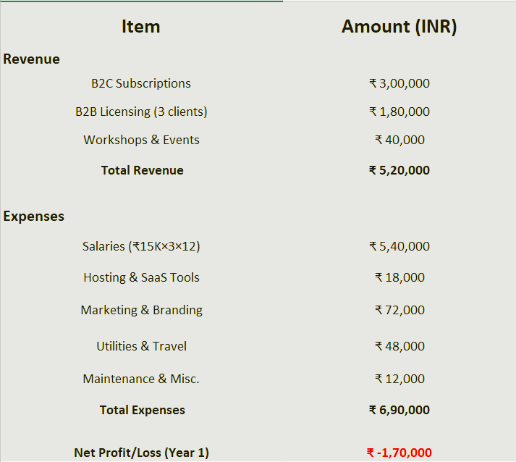
Notes:
Revenue Breakdown:
B2C Subscriptions – ₹3,00,000
→ Our initial user base through individual learners subscribing to our platform’s monthly or yearly plans.
→ We target early adopters through student communities and online promotions.
B2B Licensing (3 clients) – ₹1,80,000
→ Revenue generated by licensing our platform to 3 institutional clients (like colleges or training institutes).
→ Each client pays a fixed annual fee.
Workshops & Events – ₹40,000
→ Revenue from organizing educational workshops and bootcamps.
→ This includes both online and offline participation charges.
📊 Total Revenue – ₹5,20,000
Expense Breakdown:
Salaries – ₹5,40,000
→ Based on 3 employees with ₹15,000 monthly salary for 12 months.
→ These are critical roles like tech support, marketing, and content creation.
Hosting & SaaS Tools – ₹18,000
→ Includes cloud storage, website hosting, analytics tools, etc.
Marketing & Branding – ₹72,000
→ Targeted social media ads, influencer collaborations, brochures, and branding campaigns.
Utilities & Travel – ₹48,000
→ Internet, electricity, and essential travel expenses for client meetings or offline events.
Maintenance & Miscellaneous – ₹12,000
→ Minor hardware, subscriptions, emergency funds, etc.
📊 Total Expenses – ₹6,90,000

Slide 25
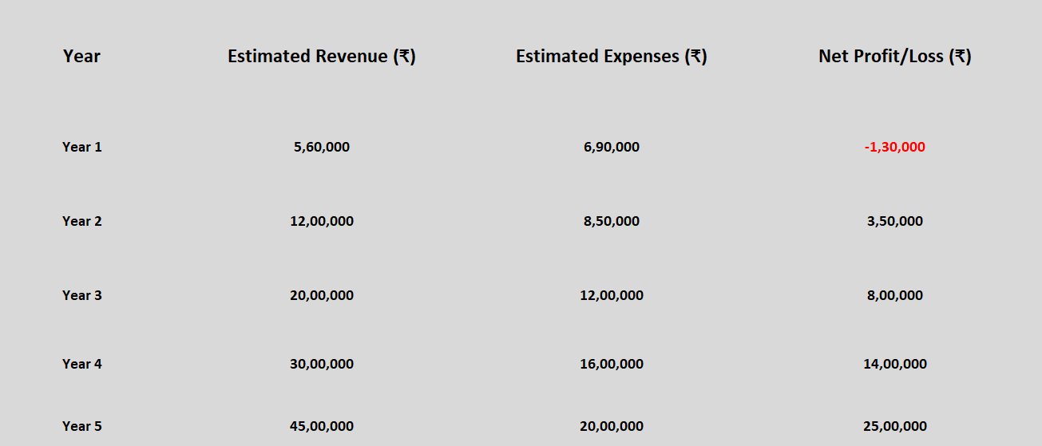

Slide 26
VENDOR
DETAILS

Slide 27
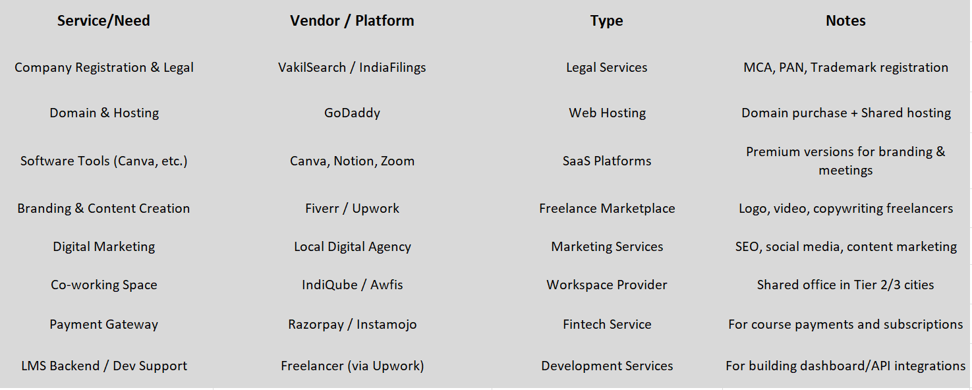
Notes:
1. Company Registration & Legal
Vendor: VakilSearch / IndiaFilings
Type: Legal Services
Purpose:
Company ah officially register panna (MCA portal)
PAN, GST, and trademark registration panna
Legal structure (LLP / Pvt Ltd) setup panna
Importance: Legal ah one-time setup, future investors paakumbodhu must-have.
2. Domain & Hosting
Vendor: GoDaddy
Type: Web Hosting
Purpose:
eduvibe.in maari oru domain vaanganum
Website upload panna hosting space thevai
Note: Shared hosting la start pannalam (cheap & basic)
3. Software Tools (Canva, etc.)
Vendor: Canva, Notion, Zoom
Type: SaaS Platforms
Purpose:
Canva → Posters, Insta ads
Notion → Team planning
Zoom → Online meetings/workshops
Note: SaaS tools monthly subscription-based.
4. Branding & Content Creation
Vendor: Fiverr / Upwork
Type: Freelance Marketplace
Purpose:
Logo, short videos, brochure
Freelancers kitta outsource panna cost-effective
Note: Initial branding-ku sema useful.
5. Digital Marketing
Vendor: Local Digital Agency
Type: Marketing Services
Purpose:
SEO (Google visibility)
Instagram/Facebook marketing
Blog or content marketing
Note: EduVibe ku target audience reach panna romba important.
6. Co-working Space
Vendor: IndiQube / Awfis
Type: Workspace Provider
Purpose:
Physical team irundha shared office setup
Tier 2/3 cities la cost kammi
Note: Investor meetings / operations ku helpful.
7. Payment Gateway
Vendor: Razorpay / Instamojo
Type: Fintech Service
Purpose:
Course fees / subscriptions online collect panna
Note: Easy integration + monthly reports.
8. LMS Backend / Dev Support
Vendor: Freelancers via Upwork
Type: Development Services
Purpose:
Dashboard, APIs, backend work
Note: Freelancers la initial build cheaper.

Slide 28
FUTURE PLANS

Slide 29
2025 – Launch & Validation
2026 – Market Penetration
2027 – Nationwide Scale
2028 – Diversification
2029 – Global Reach & Monetization
Notes:
2025 – Launch & Validation
“In 2025, our main focus is to finalize the MVP – the Minimum Viable Product of EduVibe.
We’ll conduct beta testing with over 500 students to gather real feedback.
Based on that, we’ll iterate, debug, and improve our platform.
We also aim to build strong partnerships with academic institutions to ensure credibility and early traction.”
2026 – Market Penetration
“Once we’ve validated the product, 2026 is all about scaling.
We plan to expand to 10+ major universities across India.
At the same time, we’ll launch our Android and iOS mobile apps.
To reach more users, we’ll leverage social media and influencer marketing.
Also, we’ll introduce an AI-based personalized learning dashboard for better user experience.”
2027 – Nationwide Scale
“By 2027, our goal is nationwide presence.
We’ll onboard 50+ academic partners and expert mentors.
EduVibe will partner with EdTech companies and government schemes for greater impact.
We’ll also launch the EduVibe Analytics Suite for institutions to track learning progress,
and integrate with existing LMS platforms like Moodle and Google Classroom.”
2028 – Diversification
“In 2028, we plan to diversify.
We’ll introduce EduVibe for Careers – a module with resume builders, mock interviews, and placement training.
To make it accessible, we’ll support regional languages like Tamil and Hindi.
We’ll also gamify learning using interactive features to keep users engaged.
On top of that, our ML-based engine will recommend the best courses based on each student’s learning pattern.”
2029 – Global Reach & Monetization
“Finally, in 2029, we aim to expand EduVibe to South Asian countries like Sri Lanka, Nepal, and Bangladesh.
We’ll roll out subscription plans with flexible pricing for students and institutions.
Our B2B SaaS version will cater to coaching centers and colleges.
And lastly, we’ll introduce AI-powered virtual mentors that guide learners 24/7.”

Slide 30
Limitations and Challenges
User Trust in AI: Some users hesitate to rely on AI for personalized education and interview preparation.
Internet Accessibility: Reaching rural or low-bandwidth areas still poses connectivity challenges.
Data Privacy: Ensuring secure handling of user data is critical with AI-driven personalization.
Content Localization: Adapting quality content for multiple regional languages is resource-intensive using NLP.
Market Competition: Standing out in a crowded EdTech market requires continuous innovation and brand building.

Slide 31
We see these challenges not as roadblocks, but as opportunities to grow, innovate, and build a stronger, more inclusive platform

Slide 32
Unique Selling Proposition
AI-Powered Mock Interviews: Simulates real-world interviews based on user profile and job role.
Hyper-Personalized Learning Paths: Adapts to each learner’s pace, goals, and strengths.
Mobile-First & Multilingual Support: Designed for accessibility across rural and urban India.
Career Readiness Focus: Goes beyond academics to build practical, job-ready skills.
Tiered Pricing Model: Affordable for individuals, scalable for institutions.
Social Impact Integration: CSR initiatives focused on digital literacy, teacher training, and ethical AI awareness.

Slide 33
We don't just offer content—we create customized journeys toward confidence, competence, and career success

Slide 34
Conclusion
EduVibe AI is more than a platform—it's a leap toward personalized, career-focused education for all.
We bridge the gap between learning and employability with AI-powered, accessible, and inclusive solutions.
With innovation at our core and impact as our mission, we're set to transform education across India.
Together, let’s build not just a product—but a movement to democratize education and empower futures.
Notes:
EduVibe AI is a movement to make education smarter, more personal, and truly accessible—bridging the gap between learning and real-world success through the power of AI.

Slide 35



Slide 36
Thank You

